Slide 1
Impact of Student and Staff Diversity on Student 6-year graduation rates
Data 5100 – Final Presentation
David Abney, Hrishikesh Deepak Dhole,
Chang He, Michael Palacioz

Slide 2
The Problem
Can a change in the percentage of the diversity of a student body predict changes in graduation rates?
Can a change in the percentage of the diversity of faculty predict changes in graduation rates?
What is the relationship between student body diversity rates and faculty diversity rates to the total graduation rate and the graduation rate of different races and ethnic groups?

Slide 3

Why these questions?
Research has shown that students from underrepresented backgrounds are more likely to graduate when they see themselves represented on campus ^{(1, 2, 3, 4)}
Seattle University, like many institutions are, seeing an increase in the number of students from underrepresented backgrounds
1) Flaherty, C. (2022, December 2). Faculties So White. Report finds faculty diversity isn't meeting student needs . Retrieved December 2, 2022,
from https://www.insidehighered.com/news/2022/12/02/report-finds-faculty-diversity-isnt-meeting-student-needs#.Y4oCl_sZDTs.linkedin
2) Interfolio Team. (2022, August 18). The benefits of diversity in higher education. Interfolio. Retrieved October 9, 2022,
from https://www.interfolio.com/resources/blog/the-benefits-of-diversity-in-higher-education/#:~:text=Improved%20Student%20Engagement%20and%20Retention,of%20students%20from%20underrepresented%20groups.
3) Smith, D. G., Turner, C. S., Osei-Kofi, N., & Richards, S. (2004). Interrupting the Usual: Successful Strategies for Hiring Diverse Faculty. The Journal of Higher Education, 75(2),
133–160. http://www.jstor.org/stable/3838827
4) Tam, M. Y., & Bassett, G. W. (2004). Does diversity matter? measuring the impact of high school diversity on freshman GPA. Policy Studies Journal, 32(1), 129–143. https://doi.org/10.1111/j.0190-292x.2004.00056.x

Slide 4
The Data

Slide 5
The Data Source
Integrated Postsecondary Education Data System (IPEDS)
Database that uses data collected annually by the U.S. Department of Education’s National Center for Education Statistics (NCES)
Every college, university, and technical and vocational school that participates in the federal student aid program is required to report the following information yearly
Institutional Characteristics, enrollment, program completion, graduation rates, faculty and staff, finances, institutional prices, and student financial aid
Our group used information pertaining to enrollment numbers, graduation/completion numbers, financial aid data, endowment, faculty and staff numbers for all public 4-year degree-granting institutions

Slide 6
The Dataset
IPEDS Data
IPEDS data is accessible to anyone but our group had to download multiple excel files for each area we wanted data for (enrollment numbers, graduation/completion numbers, faculty and staff numbers, and financial aid data) by year
IPEDS has multiple variables in each excel book and we had to determine which variables we wanted to use
We pulled data for all 4-year Degree-Granting Institutions that participate in IPEDS.
In total, IPEDS collects data from 6,289 institutions in 2020, however since we looked at public 4-year degree-granting institutions, we had 497

Slide 7
The Dataset
In total, we had seven ”buckets” of variables, with 63 total
Information (Institution ID, institution name, Year)
150% Graduation (6-year) Numbers divided into total and nine different groups
Cohort numbers divided into total and nine different groups. Cohort numbers are reported for when the class entered (6 years prior to the reporting year)
12-month total non-duplicated enrollment numbers divided into total and nine different groups
Number for faculty and staff divided into total and nine different groups
Endowment information
Financial aid information
We used the data collected from 2013 and later
Nine Groups
American Indian & Alaskan Native
Asian
African American
Hispanic
Hawaiian and Pacific Islander
White
2 or More
Unknown
Non-resident Alien (International)

Slide 8
The Dataset – Financial Aid and Endowment
IPEDS groups Financial Aid Data into five groups by Parents and Students Adjusted Gross Income (EFC) by first-time degree-seeking undergraduate students
1: $0 - $30,000
2: $30,001 - $48,000
3: $48,001 - $75,000
4: $75,001 - $110,000
5: $110,001 +
We had to remove all private schools since the income level of students was not reported
Endowments are funds that universities use to achieve short and long-term goals from organizations and individual donors. These funds are invested to extend the life of the endowment. Donors can stipulate how and when the university spends this money.
All US institutions have around $691 billion in endowments

Slide 9
Data Processing
Used Python to combine the data we needed into one excel file to upload into Colab
Graduation Rate Percentage
Calculated by dividing Graduation Numbers by Cohort Numbers
Percentage Calculations for Enrollment and Faculty & Staff
Given the vast size difference across institutions, we calculated percentages for eight of the nine groups reported by IPEDS. We excluded International Students and unknown
Black, Indigenous, People of Color Percentage (BiPOC)
We calculated an overall BiPOC Percentage for Graduation, Enrollment, and Faculty & Staff
This was done by using American Indian & Alaskan Native, Asian, African American, Hispanic, Hawaiian and Pacific Islander, and 2 or More categories reported by IPEDS
Percentage of students in each income level
There were where very few missing data numbers, and we dropped rows with NA values however some schools did have 0 numbers for certain years for certain ethnic groups.

Slide 10
Analysis

Slide 11
Analysis
Supervised Learning
Students were labeled as graduated
Regression Problem
Response variable is graduation percentage, which is quantitative
Looking to see if there are relationships between increases in ethnicities and race populations and the graduation rates

Slide 12
Variables
Dependent:
BiPOC graduation rate
Total graduation rate
Graduation rate for each ethnicity and race
Independent:
BiPOC enrollment percentage
BiPOC cohort percentage
BiPOC staff percentage
University endowment
Percentage of students in certain family income levels

Slide 13
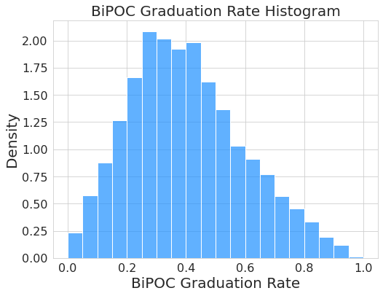
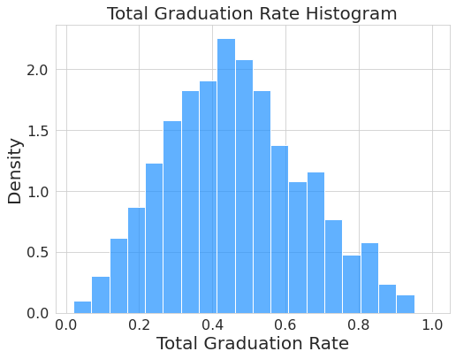
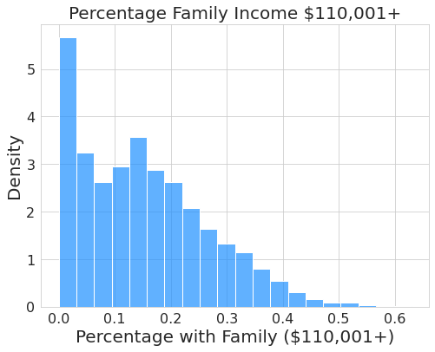
Exploratory Analysis

Slide 14
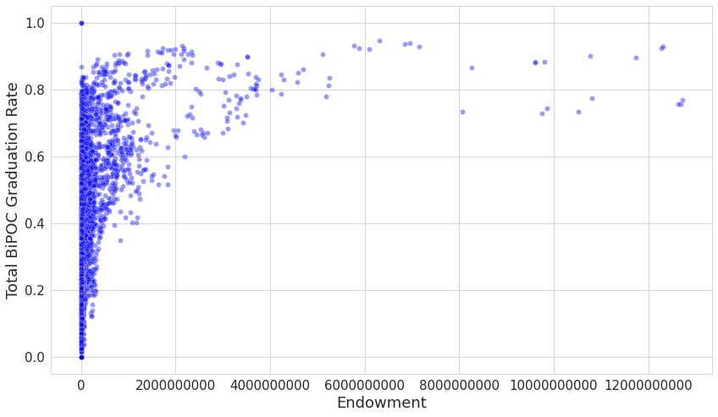
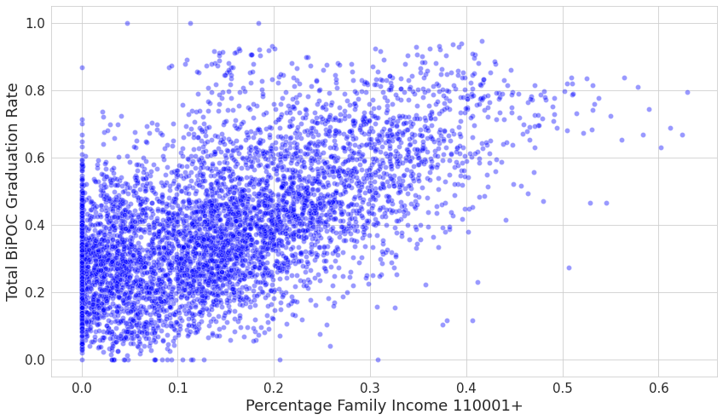

Slide 15
Modeling
Multiple linear regression
Random Forest
Models without endowment and income levels performed very poorly
Including endowment and income levels assisted in accounting for the different quality in universities

Slide 16
Modeling
Linear Regression
Easier to understand the relationship
Random Forest model
Helped check if non-linear relationships existed
Label the most important variables
Unable to discover the non-linear relationships

Slide 17
Results

Slide 18
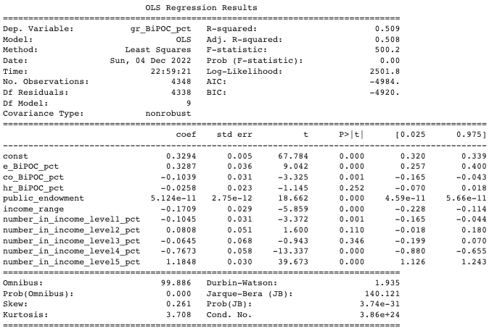
Mean Squared Error:
0.136
Multiple Linear Regression BiPOC Graduation Rate

Slide 19
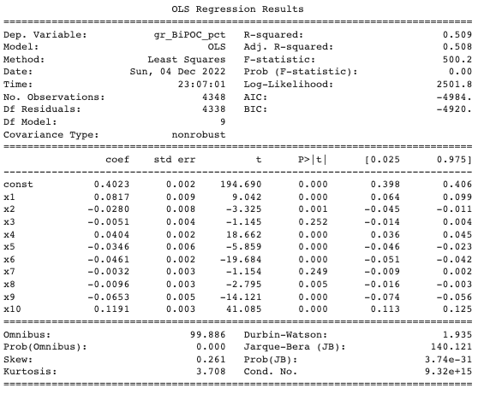
Mean Squared Error:
0.136
Scaled Multiple Linear Regression BiPOC Graduation Rate

Slide 20
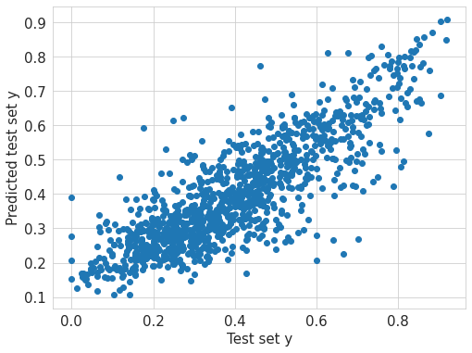
Mean Squared Error:
0.106
Random forest for BiPOC graduation rate. Testing predicted values against actual values

Slide 21
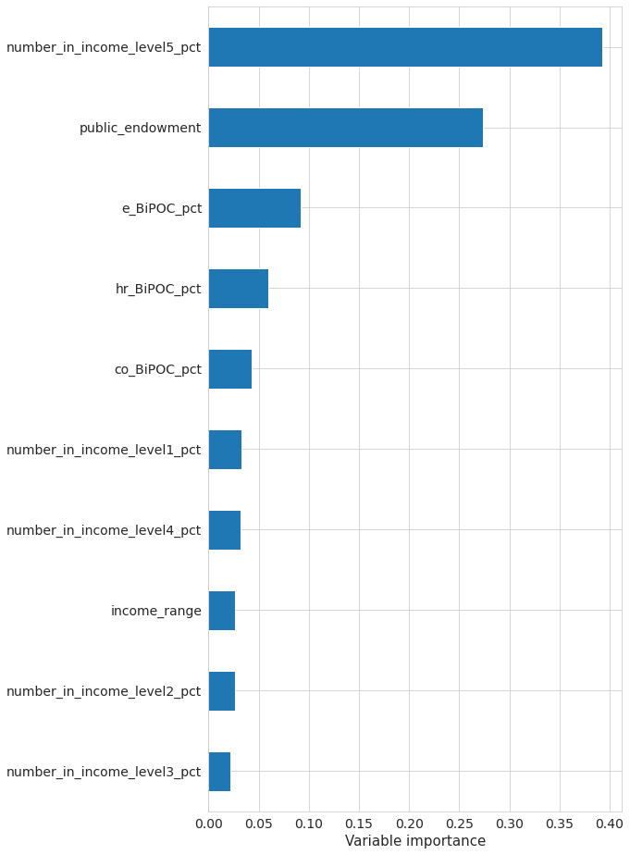
Variable of importance for Random forest for BiPOC graduation rate.

Slide 22
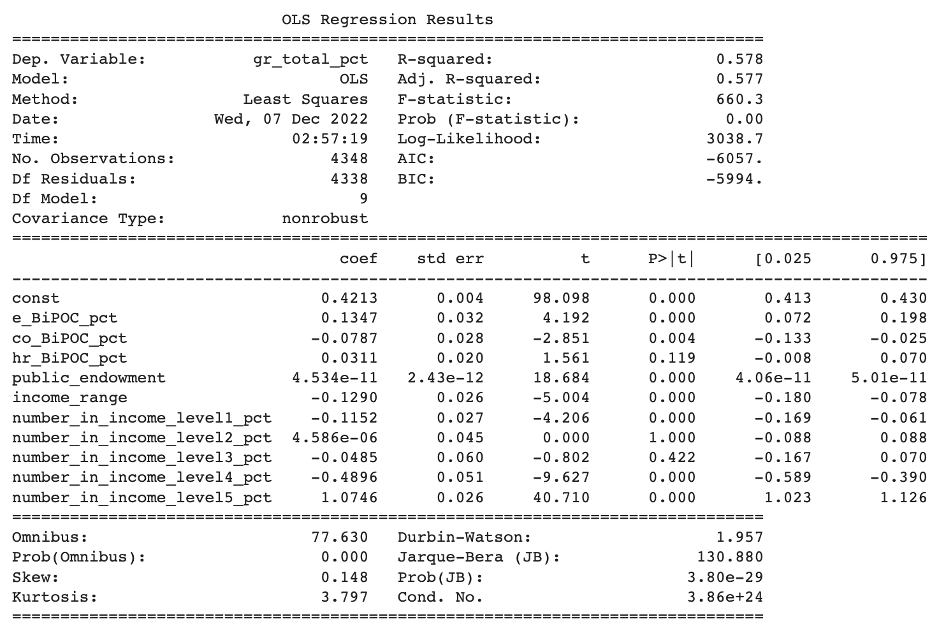
Mean Squared Error:
0.121
Multiple Linear Regression on Total Graduation Rate

Slide 23
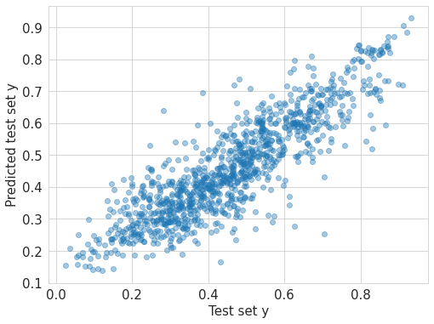
Mean Squared Error:
0.091
Random forest for overall graduation rate. Testing predicted values against actual values

Slide 24
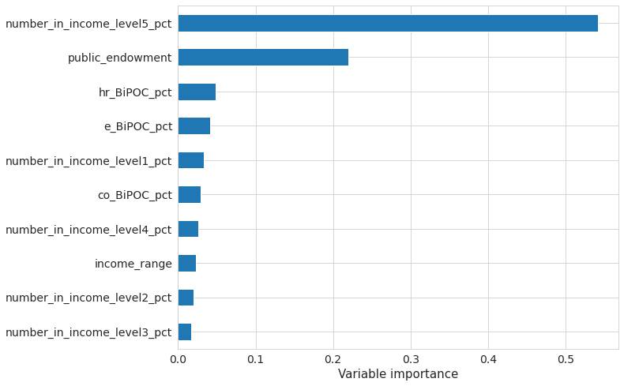
Variable of importance for overall graduation rate.

Slide 25
Conclusion

Slide 26
Conclusion
With enrollment percentage, faculty and staff percentage, financial aid information and endowment information, we can predict the overall graduation rate for BiPOC student graduation rate.
There is a statistically significant relationship between BiPOC enrollment percentage and BiPOC graduation rate.
There is a statistically significant relationship between BiPOC enrollment percentage and total graduation rate.
There was a statistically nonsignificant relationship between BiPOC Faculty and Staff Percentage and BiPOC graduation rate.

Slide 27
THANKS!
Any questions?

